Slide 1




Next Gen Employability Program
FullStack Web Development With AI Tools
Team Details – NG_CP_Team_401
Name: Aaryan Budakoti
Name: Aabhas Katyal
Name: Piyush Sharma
College: Inderprastha Engineering College, Ghaziabad

Slide 2

The content is curated from online/offline resources and used for educational purpose only.
Notes:
Speaker would be briefing the students that this content has been prepared for the educational purpose only and is referred from multiple sites which are cited in the last.​​
---------------------------------------------------​​
A disclaimer is a statement or notice that is intended to clarify, limit, or provide information about the scope, limitations, or potential risks associated with certain actions, information, products, services, or content. ​​
​​
​

Slide 3

Project Title
EVENTX- College Event Management System
Notes:
In this slide speaker will be introducing the program and its outcomes. The speaker will introduce himself in brief

Slide 4

Table of Contents
Introduction
Problem Statement
Proposed Solution
Key features
Technology stack
System flowchart
Core Modules
Security measures
Conclusion and Future work
References
Notes:
This slide, The speaker will talk about the content that we will be covering in this session as follows:
Introduction
Importance of UI/UX in industry
History and Definitions of UI and UX
Key Differences between UI/UX
Use Cases
Significance in Web Development
Use Cases
Visual Design Principles
Design process
Color theory and psychology
Typography and readability
Layout and Spacing
Responsive design basics
Usability and Accessibility
Usability Aspects
Web Content Accessibility Guidelines (WCAG)
Inclusive design practices
Consistency
User Experience
User-Centered Design
User research methods
Interactive Elements and Feedback
Mini Case Study
Discussing a popular UI/UX design
Hands-On
Introduction to Figma for UI/UX design

Slide 5

Introduction:
In today’s academic environment, colleges conduct multiple technical, cultural, and sports events regularly. Managing these events manually leads to inefficiency and data mismanagement. The College Event Management System is a web-based application that provides a digital platform for organizing events and handling student registrations efficiently using Django.
Notes:
This slide, The speaker will talk about the content that we will be covering in this session as follows:
Introduction
Importance of UI/UX in industry
History and Definitions of UI and UX
Key Differences between UI/UX
Use Cases
Significance in Web Development
Use Cases
Visual Design Principles
Design process
Color theory and psychology
Typography and readability
Layout and Spacing
Responsive design basics
Usability and Accessibility
Usability Aspects
Web Content Accessibility Guidelines (WCAG)
Inclusive design practices
Consistency
User Experience
User-Centered Design
User research methods
Interactive Elements and Feedback
Mini Case Study
Discussing a popular UI/UX design
Hands-On
Introduction to Figma for UI/UX design

Slide 6

PROBLEM STATEMENT:
Traditional college event management systems rely on manual registration and record keeping.
This results in:
Time-consuming processes
Registration errors
Difficulty in tracking participants
Poor coordination between students and administrators
A centralized, digital, and secure system is required to manage events efficiently.
Notes:
This slide, The speaker will talk about the content that we will be covering in this session as follows:
Introduction
Importance of UI/UX in industry
History and Definitions of UI and UX
Key Differences between UI/UX
Use Cases
Significance in Web Development
Use Cases
Visual Design Principles
Design process
Color theory and psychology
Typography and readability
Layout and Spacing
Responsive design basics
Usability and Accessibility
Usability Aspects
Web Content Accessibility Guidelines (WCAG)
Inclusive design practices
Consistency
User Experience
User-Centered Design
User research methods
Interactive Elements and Feedback
Mini Case Study
Discussing a popular UI/UX design
Hands-On
Introduction to Figma for UI/UX design

Slide 7
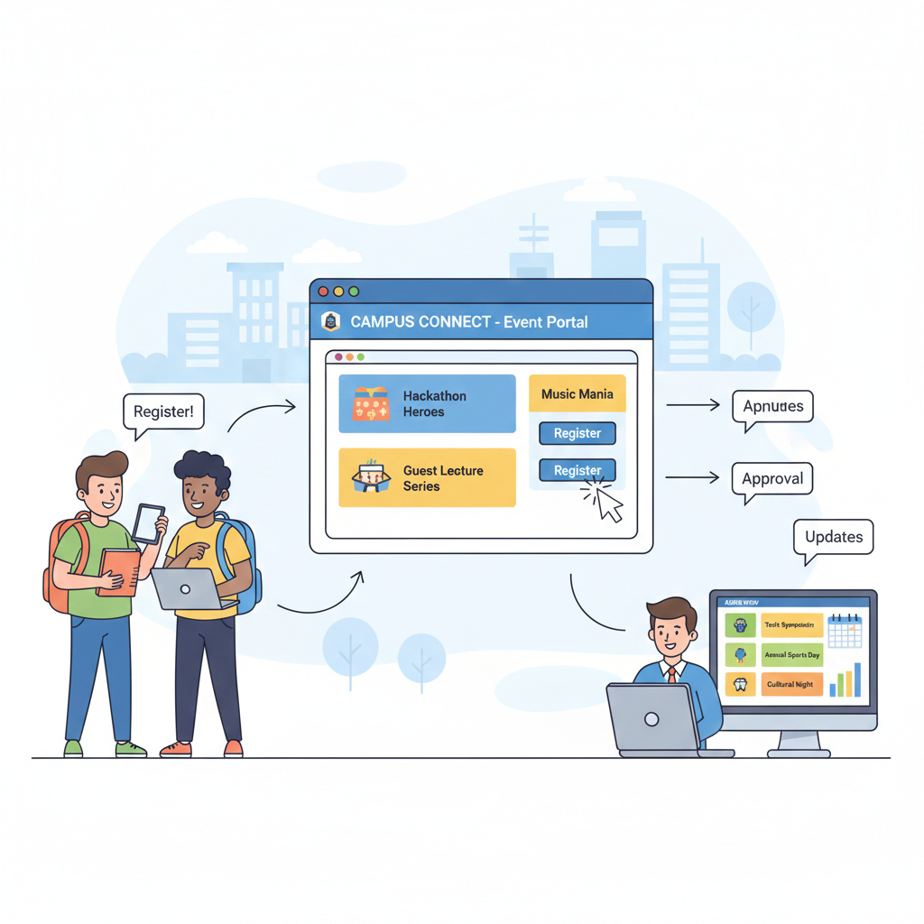
PROPOSED SOLUTION:
To overcome these challenges, a College Event Management System is proposed.
The system allows:
Students to register, log in, view events, and enroll online
Admins to create, update, and manage events and registrations
This solution significantly reduces manual effort involved in managing college events.
It minimizes errors that occur during traditional paper-based registrations. The system improves accuracy by maintaining centralized and organized data. It enables faster event registration and better coordination between users and admins.
Notes:
This slide, The speaker will talk about the content that we will be covering in this session as follows:
Introduction
Importance of UI/UX in industry
History and Definitions of UI and UX
Key Differences between UI/UX
Use Cases
Significance in Web Development
Use Cases
Visual Design Principles
Design process
Color theory and psychology
Typography and readability
Layout and Spacing
Responsive design basics
Usability and Accessibility
Usability Aspects
Web Content Accessibility Guidelines (WCAG)
Inclusive design practices
Consistency
User Experience
User-Centered Design
User research methods
Interactive Elements and Feedback
Mini Case Study
Discussing a popular UI/UX design
Hands-On
Introduction to Figma for UI/UX design

Slide 8
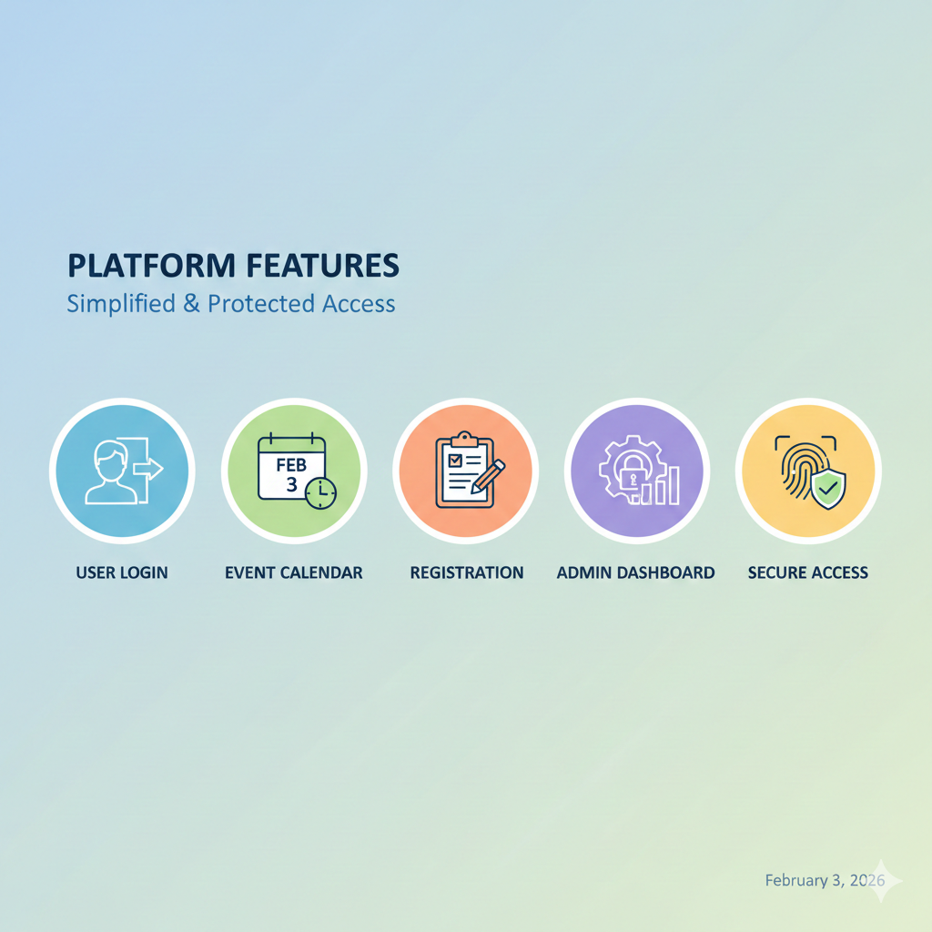
KEY FEATURES:
User Registration and Login
Event Browsing and Online Registration
Registration Management for Users
Admin Dashboard for Event Control
Secure Authentication System
Notes:
This slide, The speaker will talk about the content that we will be covering in this session as follows:
Introduction
Importance of UI/UX in industry
History and Definitions of UI and UX
Key Differences between UI/UX
Use Cases
Significance in Web Development
Use Cases
Visual Design Principles
Design process
Color theory and psychology
Typography and readability
Layout and Spacing
Responsive design basics
Usability and Accessibility
Usability Aspects
Web Content Accessibility Guidelines (WCAG)
Inclusive design practices
Consistency
User Experience
User-Centered Design
User research methods
Interactive Elements and Feedback
Mini Case Study
Discussing a popular UI/UX design
Hands-On
Introduction to Figma for UI/UX design

Slide 9
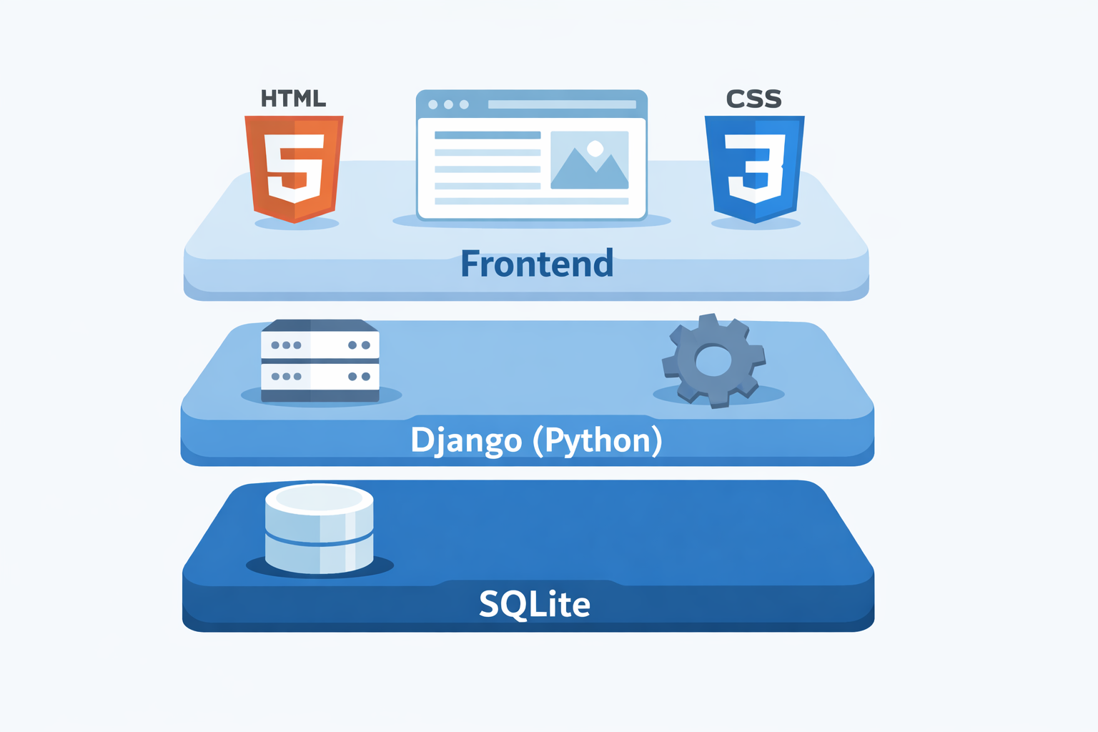
TECHNOLOGY STACK:
1. Frontend
HTML, CSS
Javascript
2. Backend
Python (Django)
Handle Events in the most effective way
3.Database
SQLite3 (db.sqlite3)
Lightweight and fast
Stores student records securely
Notes:
This slide, The speaker will talk about the content that we will be covering in this session as follows:
Introduction
Importance of UI/UX in industry
History and Definitions of UI and UX
Key Differences between UI/UX
Use Cases
Significance in Web Development
Use Cases
Visual Design Principles
Design process
Color theory and psychology
Typography and readability
Layout and Spacing
Responsive design basics
Usability and Accessibility
Usability Aspects
Web Content Accessibility Guidelines (WCAG)
Inclusive design practices
Consistency
User Experience
User-Centered Design
User research methods
Interactive Elements and Feedback
Mini Case Study
Discussing a popular UI/UX design
Hands-On
Introduction to Figma for UI/UX design

Slide 10
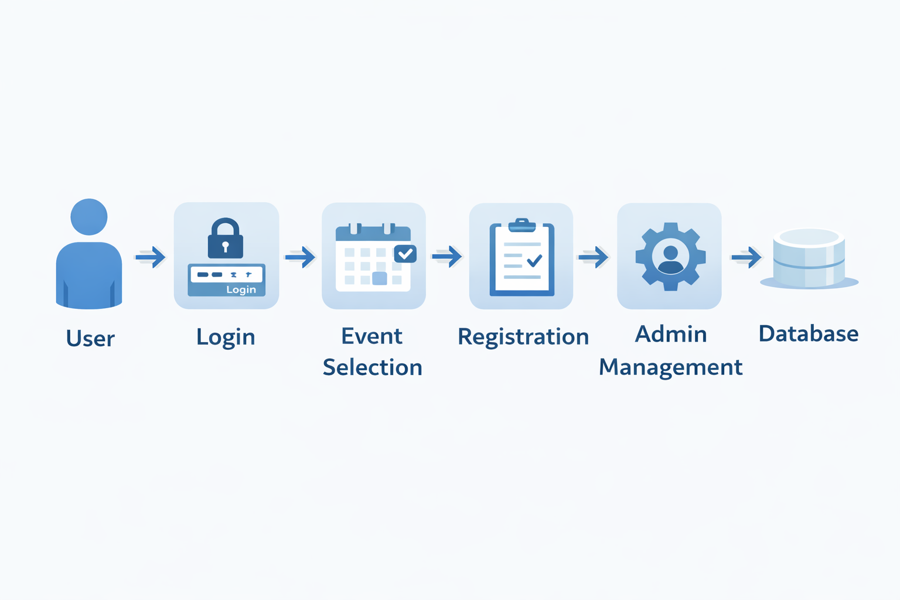
SYSTEM FLOWCHART:
User registers and logs into the system
User views available events
User registers for selected events
Admin creates and manages events
Admin views and manages all registrations
Data is stored and retrieved securely from the database
Notes:
This slide, The speaker will talk about the content that we will be covering in this session as follows:
Introduction
Importance of UI/UX in industry
History and Definitions of UI and UX
Key Differences between UI/UX
Use Cases
Significance in Web Development
Use Cases
Visual Design Principles
Design process
Color theory and psychology
Typography and readability
Layout and Spacing
Responsive design basics
Usability and Accessibility
Usability Aspects
Web Content Accessibility Guidelines (WCAG)
Inclusive design practices
Consistency
User Experience
User-Centered Design
User research methods
Interactive Elements and Feedback
Mini Case Study
Discussing a popular UI/UX design
Hands-On
Introduction to Figma for UI/UX design

Slide 11
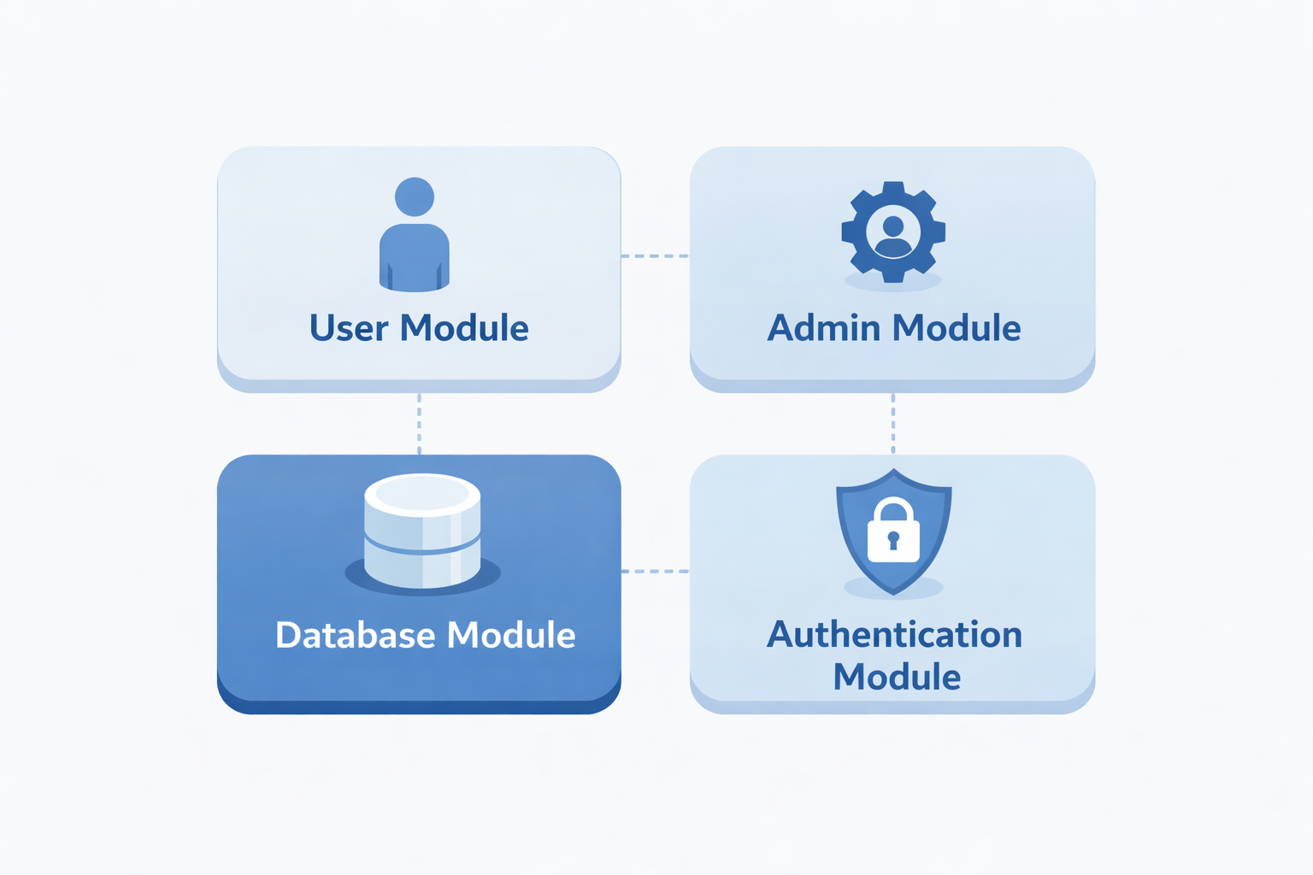
CORE MODULES:
User Module:
User registration and login
Event viewing and registration
Admin Module:
Create, update, and delete events
View and manage registrations
Database Management Module:
Uses SQLite3 to store student records
Authentication & Security Module: Restricts system access to authorized users only

Slide 12
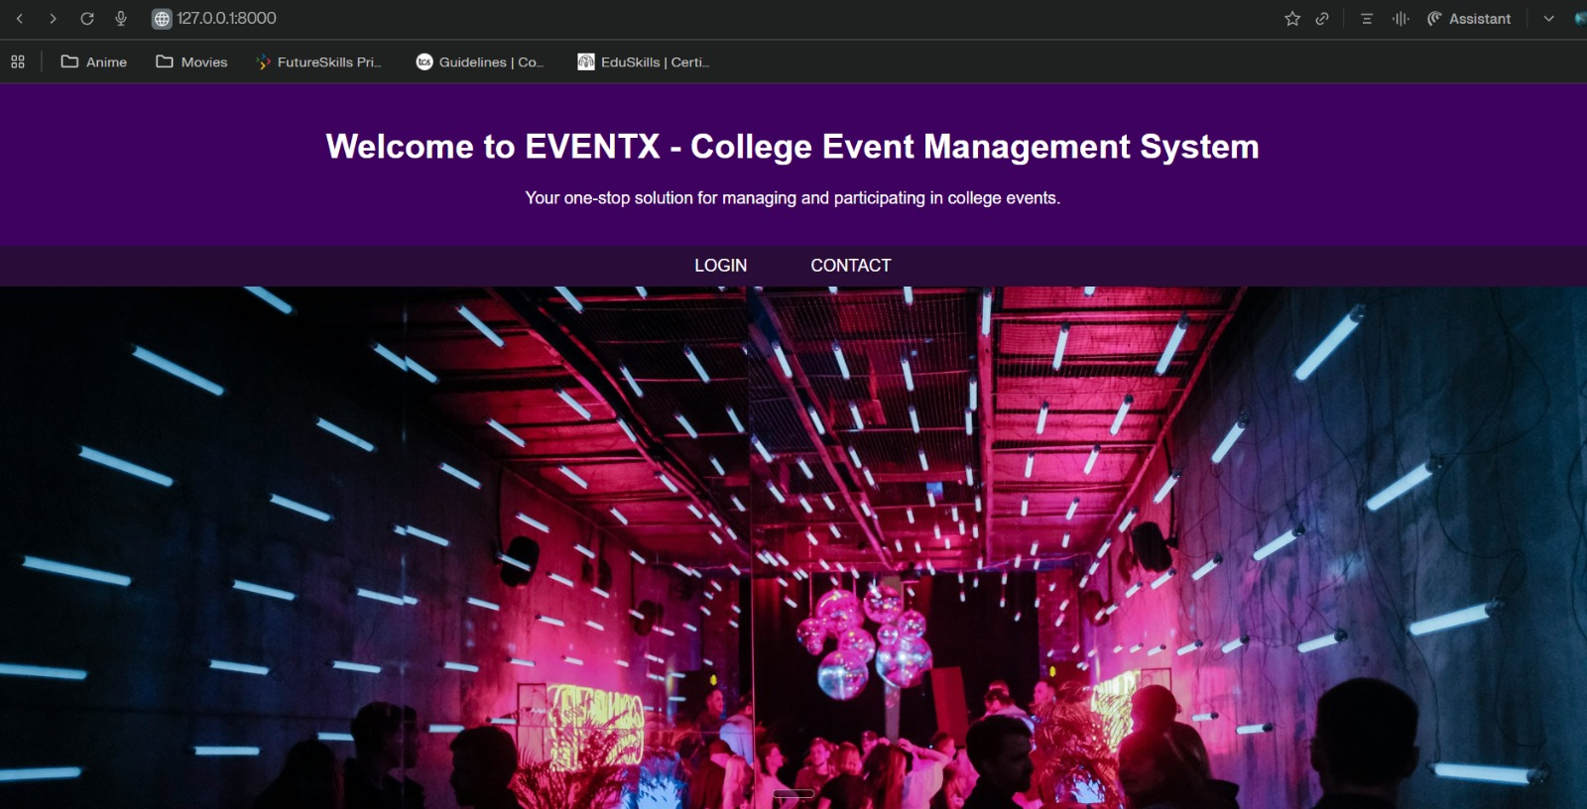
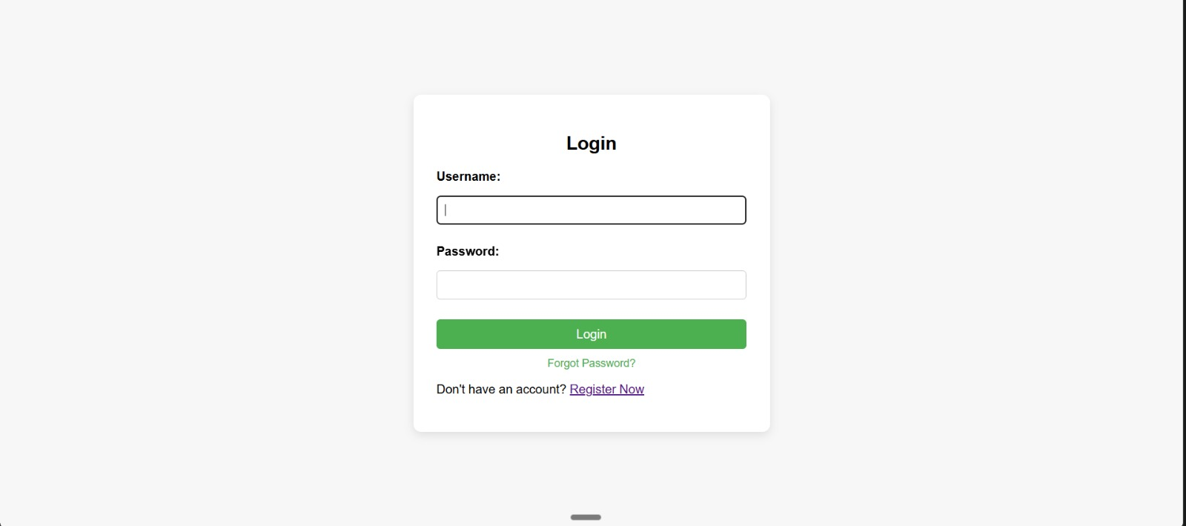

Slide 13
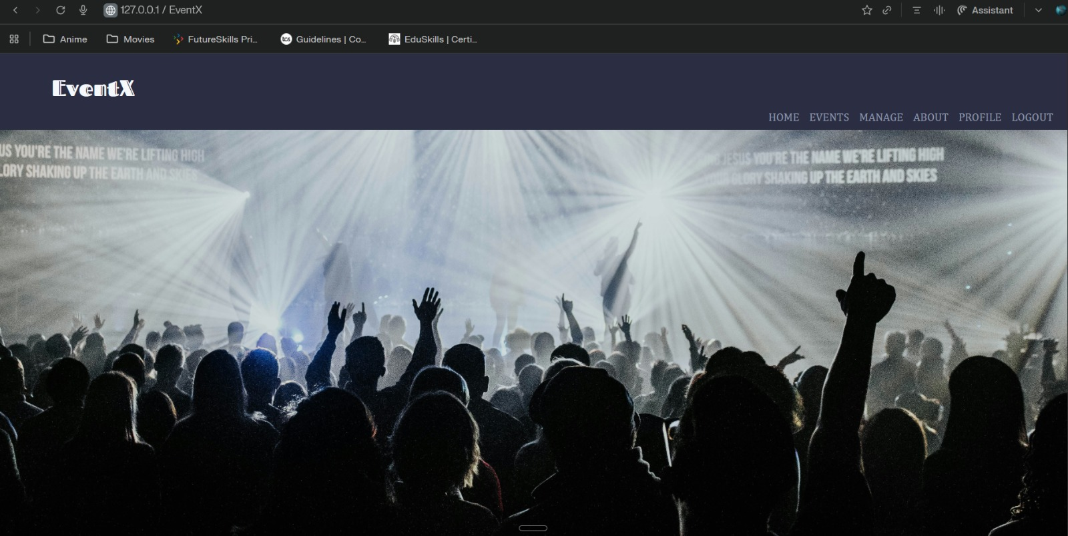
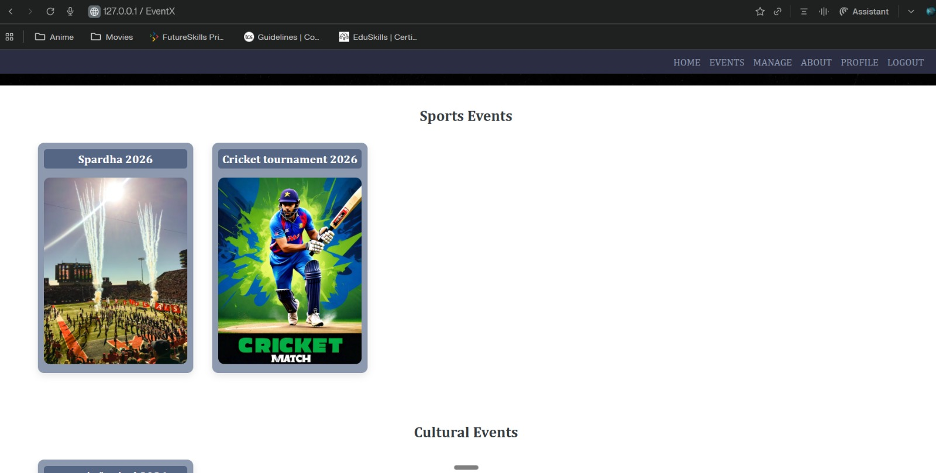

Slide 14

CONCLUSION AND FUTUREWORK:
The College Event Management System simplifies event organization by automating registration and management tasks.
It improves efficiency, accuracy, and accessibility for both students and administrators.
Future Enhancements:
Email and notification system
QR-based event check-in
Online payment integration
Analytics and reporting dashboard

Slide 15
References:
Django Documentation – https://www.djangoproject.com
Python – https://www.python.org
Notes:
This slide, The speaker will talk about the content that we will be covering in this session as follows:
Introduction
Importance of UI/UX in industry
History and Definitions of UI and UX
Key Differences between UI/UX
Use Cases
Significance in Web Development
Use Cases
Visual Design Principles
Design process
Color theory and psychology
Typography and readability
Layout and Spacing
Responsive design basics
Usability and Accessibility
Usability Aspects
Web Content Accessibility Guidelines (WCAG)
Inclusive design practices
Consistency
User Experience
User-Centered Design
User research methods
Interactive Elements and Feedback
Mini Case Study
Discussing a popular UI/UX design
Hands-On
Introduction to Figma for UI/UX design

